Slide 1
TinyTerm V2
Usage with the 3D POC
07/24/20

Slide 2
Using TinyTerm V2 with 3D POC
Download and unzip Processing on your computer
Grab the tinyTerm files from Github
Open sketch in processing
Connect the tinyG to your PC via USB cable
Boot tinyG
Run sketch [CTRL+R] (or click the arrow)
Select second COM port on the list
Load init file (3D_INIT.json)
Home the machine
Enjoy

Slide 3
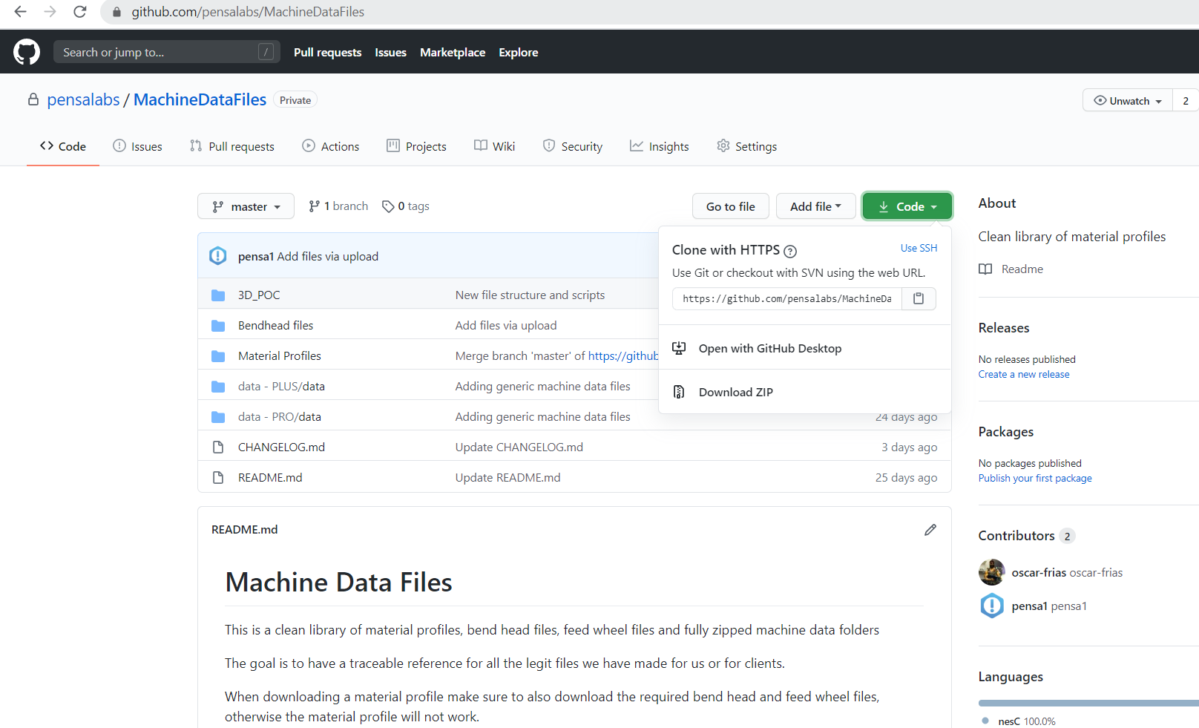
Grab the init file and sample scripts from Pensa’s github
Same deal as before:
Click on the green button
Download zip
Extract files
You’re only interested in the files inside the “3D_POC” folder

Slide 4
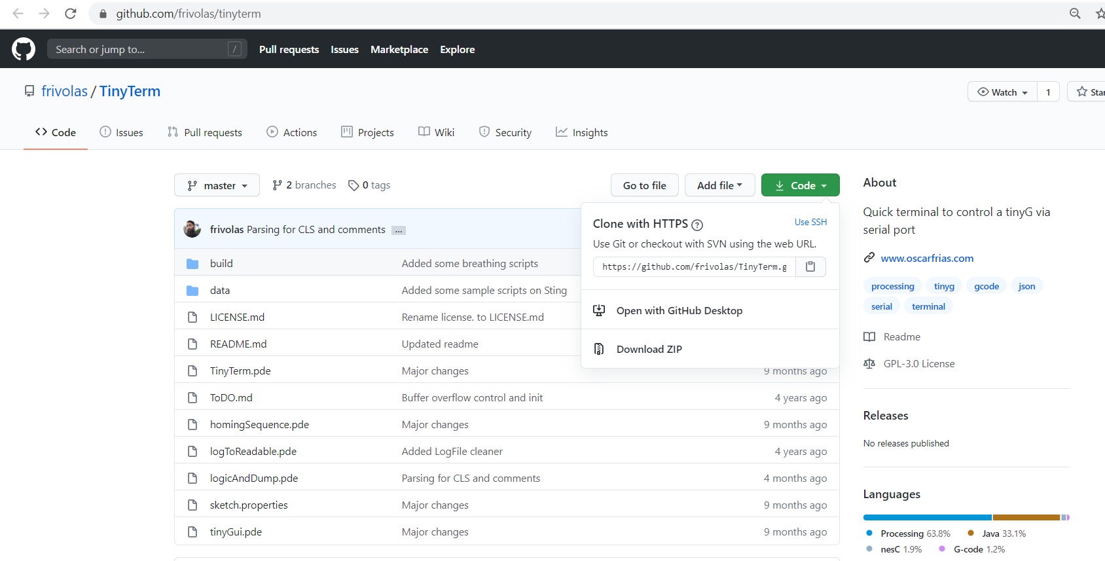
Grab tinyTerm V2 from github
Click the green button
Download zip and extract files

Slide 5
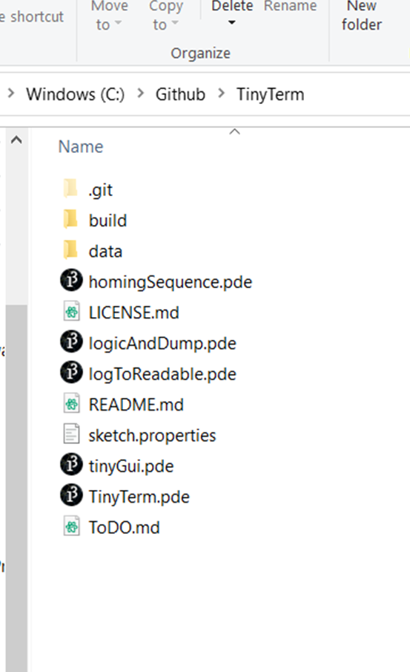
Extract files and run main sketch
Run the sketch called “TinyTerm.pde”
You’ll need to have Processing in your computer, and the controlP5 library installed

Slide 6
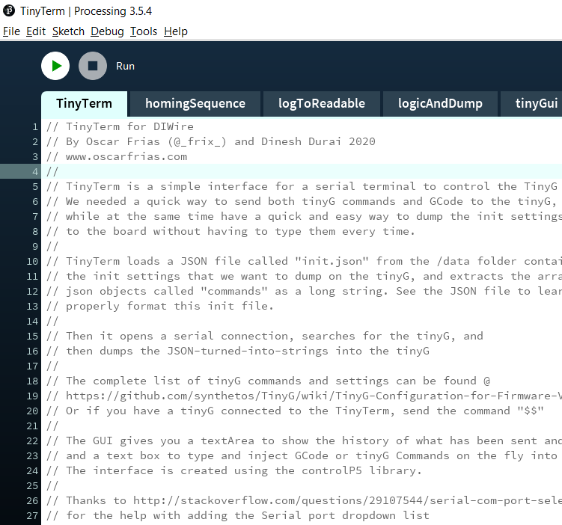
Run the sketch
Make sure the tinyG is ON and connected to your computer before running the sketch
Run the sketch by clicking on the green arrow on the top left, or by using the CTRL+R keyboard shortcut

Slide 7
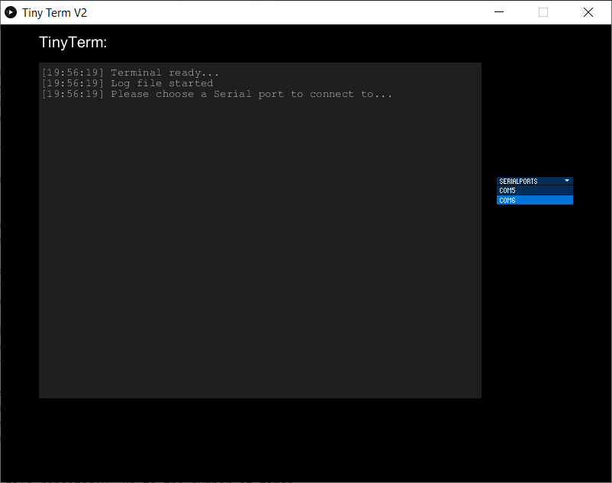
Connect to the tinyG
Once the applet loads, select the second COM port on the list. You should see some gibberish pop on the terminal, and the rest of the buttons appear.
It’s important to select the second port, otherwise you’ll be trying to talk to a ghost port opened by the tinyG, and nothing will happen.

Slide 8
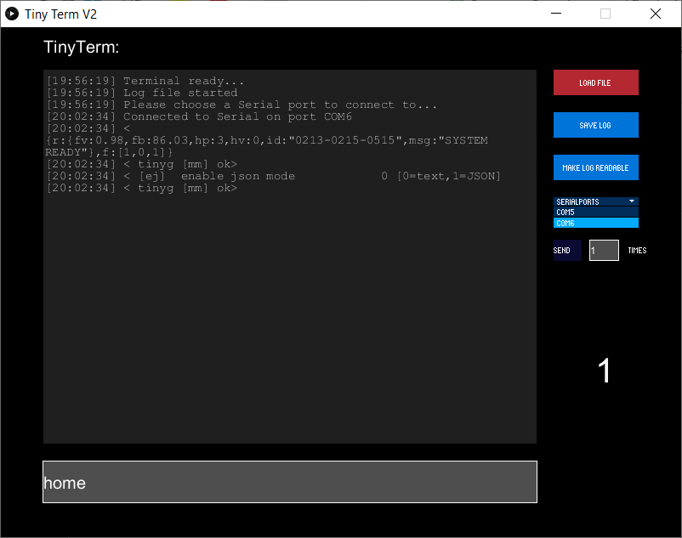
Load the init file
Click on the “Load File” button and browse for the init file.
You’ll see lots of lines get filled in the terminal, that’s OK.

Slide 9
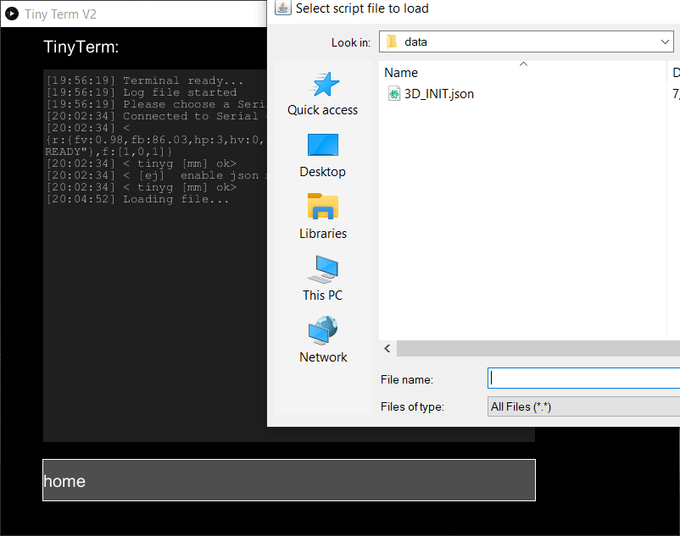
Only load the 3D POC init!
Make damn sure to open only the 3D_INIT.JSON file. Any other init file will make the machine misbehave and crash. Try not to damage the POC by mistake.

Slide 10
Home the machine
To home the machine simply type HOME (lower or upper caps ok) in the textfield and hit [Enter]
The machine will go through the motions:
Home Z axis
Home X axis
Home A axis
Go to A20 Z0
Profit!

Slide 11
TinyTerm Usage and commands

Slide 12
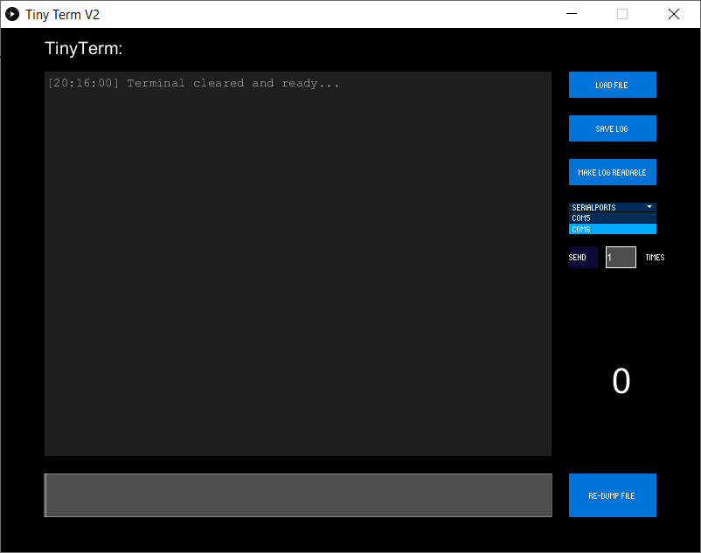
Interface
To load the init file or a gcode script
Saves the content of the terminal to a log file
Main terminal, shows all the incoming data from the tinyG
Makes the log files human readable
Serial port selector. Use only the 2nd port on the list
Repeater: Type the number of times you want your script file to be sent. Very useful if you’re making many copies of the same part.
THE FILE’S LAST LINE MUST SAY “(EOF)” FOR THE REPEATER TO WORK. Just add it as a comment at the very end of your script.
This numeral shows the remaining times that your file will be loaded (per the repeater)
Text input field. Here you can type tinyG commands, raw Gcode or tinyTerm commands (see cheat sheet next slide). Type and hit [ENTER] to execute
To re-send the last file you loaded. Useful if you’re doing quick edits to your file. Simply save the file and click re-dump, no need to load again

Slide 13
TinyTerm command cheat sheet
Command/ key | Action | Notes
Home | Home machine | Homes all 3 axes
Homea | Homes A axis only | Z axis must be homed, the machine could crash or simply miss the sensor
Homex | Homes X axis only
Homez | Homes Z axis only | The machine will search for the flag downwards. So the carriage needs to be above the sensor before homing. You can move it with G91 moves
CLS | Clears the terminal | Saves the contents of the terminal in a log file and then clears all the text. Very useful if you want to catch a particular line or if it’s too busy, or if your computer starts lagging (this terminal hogs memory, sorry. Will figure it out in the future)
Exit | Closes the app | Will save a log file and close the applet.
[ESC] | Exit prompt | The terminal will ask you if you want to exit or not, simply type ‘Y’ or ‘N’
! | Feedhold | tinyG will stop moving, but the queue is still full. Send a ‘~’ to continue
~ | Feedhold release | Continue running the program
% | Flush | Empties the queue both on tinyTerm and on the tinyG
!% | Stop and Flush | Send both characters together to perform a hard stop and flush

Slide 14
File types
Only the init files are treated specially, because they are comprised of at least two arrays that need to be extracted in a particular way. To be recognized by tinyTerm, they must have two conditions:
The filename incudes INIT
The file extension is JSON
Otherwise, TinyTerm is inclusive and promiscuous. It will load any file extension you open. The tinyG will complain or try to make sense of it if it’s not Gcode, but for most of it, it doesn’t really matter.
That said, I’d recommend you save your scripts as .txt, .nc, .gc, .tap, or whatever other format you can open with a text editor. And don’t use any special Unicode, just let Windows do its thing.

Slide 15
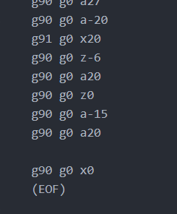
Notes about the repeater
As mentioned before, for the repeater to work, the file to be repeated MUST END WITH “(EOF)” (no quotation marks). I put it in parenthesis so the tinyG doesn’t complain of a wrong command (it’s seen as a comment).
The algorithm running the repeater looks for this three letters to determine that the file is done. I may think of a different way to do it in the future, but right now this is the way. So make sure that the last line of your file is (EOF)

Slide 16
Troubleshooting
Sometimes the homing sequence for the A axis won’t finish. The solution is to re-load the init file and re-run the homing routine. This normally works. Otherwise a good reboot will do too.
If the machine stops unexpectedly, or if the terminal stops running your commands, you can flush everything with a ‘%’ or a ‘!%’, and then send a ‘~’. This normally does the job.
Otherwise there’s not much troubleshooting to do. But this is a very simple sketch that tries to communicate with quite a snowflake of a board. So if everything fails, nothing as simple as to stopping the sketch, rebooting the tinyG and restarting the sketch (load init file, home, profit) will do it.

Slide 17
Thanks!
Let me know if you have any questions!

